Slide 1


Why I Created This Math Game
In developing this math game, I aimed to make learning and practicing math skills engaging and enjoyable for students of all ages. Through interactive gameplay and challenges, the game encourages a positive attitude towards mathematics and fosters a deep understanding of mathematical concepts.

Slide 2
Tasks for Math Game Development
Add Animations
Add Sound
Make Design
Engage players with visually appealing movements and interactions.
Enhance the gaming experience with immersive audio effects and music.
Create an intuitive and visually attractive user interface.
Make Interesting Gameplay
Add Increasing Difficulty
Create challenging and enjoyable math-related tasks and puzzles.
Gradually raise the level of challenge to keep the game engaging.

Slide 3

More tasks in the Math Game
Complex Algorithms: Implementing advanced mathematical algorithms to provide challenging gameplay and enhance the learning experience.
Intuitive Interface: Designing a user-friendly interface to ensure easy navigation and seamless interaction for players of all ages.
Efficient use of the Pygame library to optimize game performance and ensure smooth gameplay.

Slide 4

Explaining the Project
The math game is an interactive, educational application designed to make learning math concepts enjoyable for users of all ages. It incorporates engaging animations, sound effects, and an intuitive design to create an immersive gaming experience.
Players will encounter increasing difficulty levels, challenging them to apply their math knowledge in a variety of scenarios. The game is built upon complex algorithms, ensuring a unique and stimulating experience every time.

Slide 5

Target Audience
Educational Institutions
Parents and Guardians
Elementary, middle, and high school students learning math concepts in an engaging way.
Those seeking a fun and educational game to support their children's math learning at home.
Educators and Tutors
Math teachers and tutors looking for a tool to supplement classroom learning and tutoring sessions.

Slide 6


Which libraries i used to write this project?
Random library
Pygame library
I used random library to generate random numbers and create dynamic game scenarios. This adds an element of unpredictability and keeps the game fresh for players.
For all funtions related to graphics, animations, and sound effects, I utilized the Pygame library. This library provided a user-friendly interface for creating visually appealing and interactive elements in the game.

Slide 7

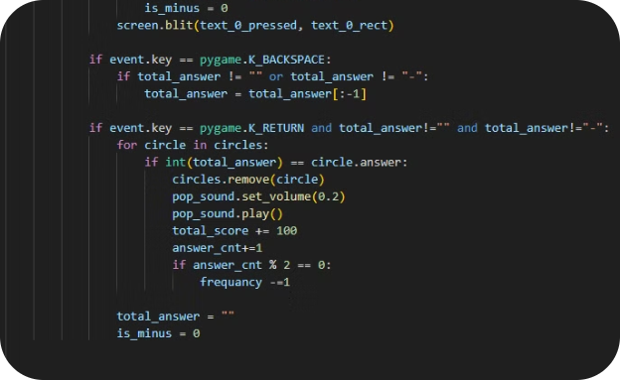
How the Math Game Works
User-Friendly Interface
Complex Algorithms
The game features an intuitive and user-friendly interface, making it easy for players to navigate and enjoy.
Behind the scenes, the game applies sophisticated algorithms to ensure that the gameplay is challenging and rewarding.

Slide 8
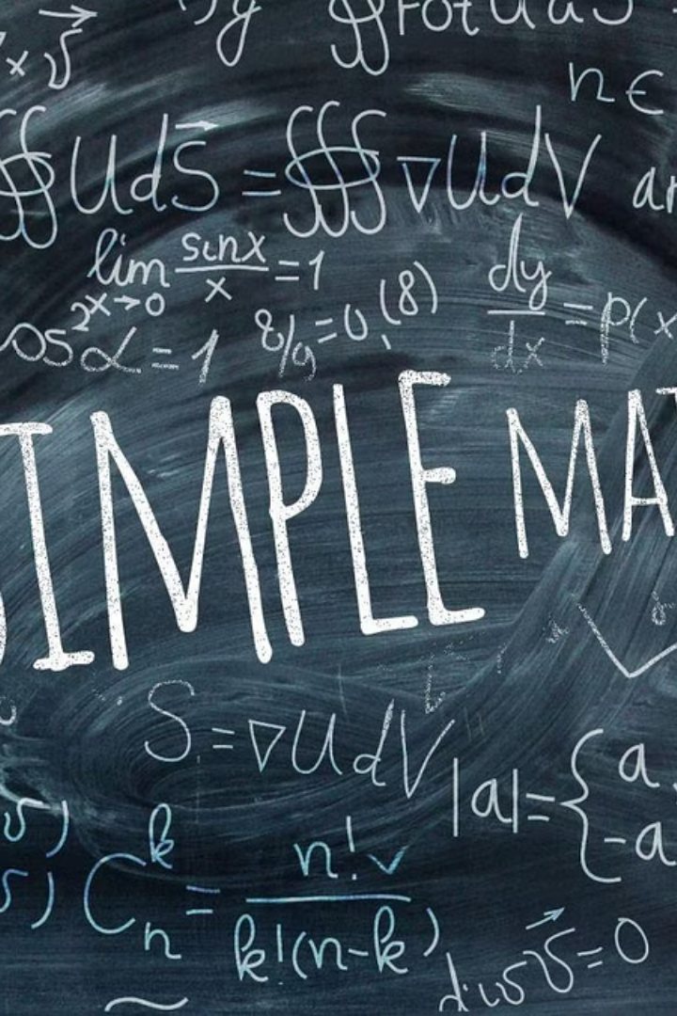
Conclusion
With a focus on engaging gameplay and intuitive interface, the math game presents an opportunity for players to strengthen their mathematical skills while having fun. Emphasizing the use of complex algorithms and increasing difficulty, the game provides a challenging yet rewarding experience for all ages.

Slide 9
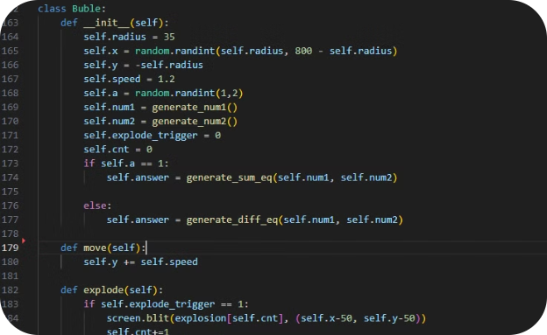
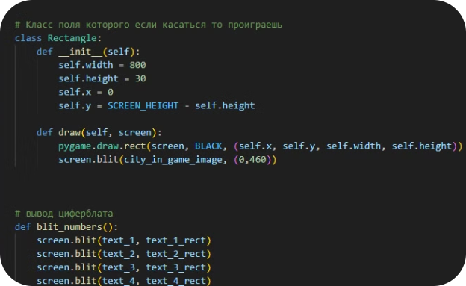
Add Pictures of the Code
Clear Syntax Highlighting
OOP structure
Utilize clear and visually appealing syntax highlighting to make the code readable and understandable.
OOP structure is made to improve code organization and readability, making it easier to navigate and understand. Including pictures of the code will help users follow along and better understand the game's inner workings.

Slide 10
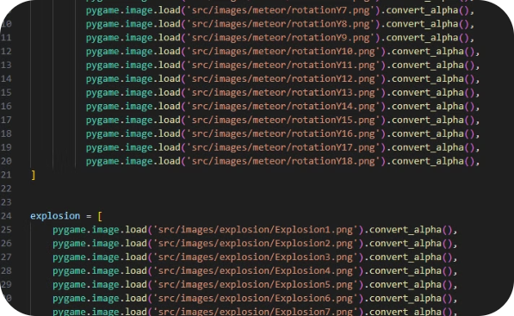
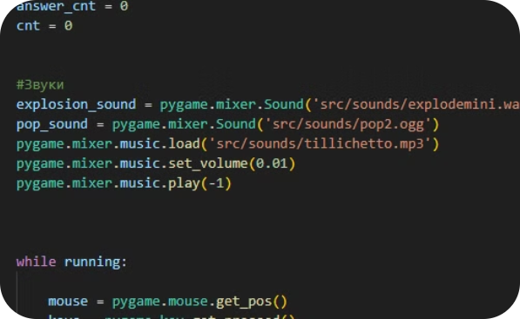
Adding animations
Sound effects
Add animations for better visual representations and to provide a more immersive experience for the players. Animations can also aid in helping players understand complex concepts and make the learning experience more enjoyable.
Adding sound effects can further enhance the overall gaming experience. By incorporating appropriate sound effects such as pop for correct answers or an explosion for incorrect ones, players can feel a greater sense of accomplishment and engagement. Additionally, sound effects can serve as helpful auditory cues, further reinforcing the learning aspect of the game.

Slide 11
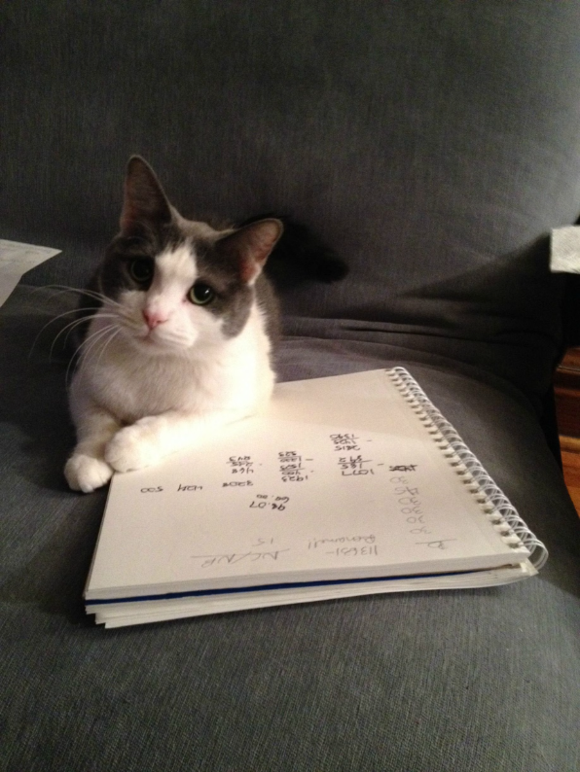
Thank You for your attention!

